Slide 1
Modelling of thermal damage from High Intensity Focused Ultrasound
Margaret Duff
12/12/2018

Slide 2
Contents
What is HIFU?
Brief introduction
Clinical set-up
Imaging
Pennes Bioheat Transfer model
Models for thermal damage
Current Work
Aims
1D spherically symmetric models
2D models
Next Steps
Questions

Slide 3
What is HIFU?

Slide 4
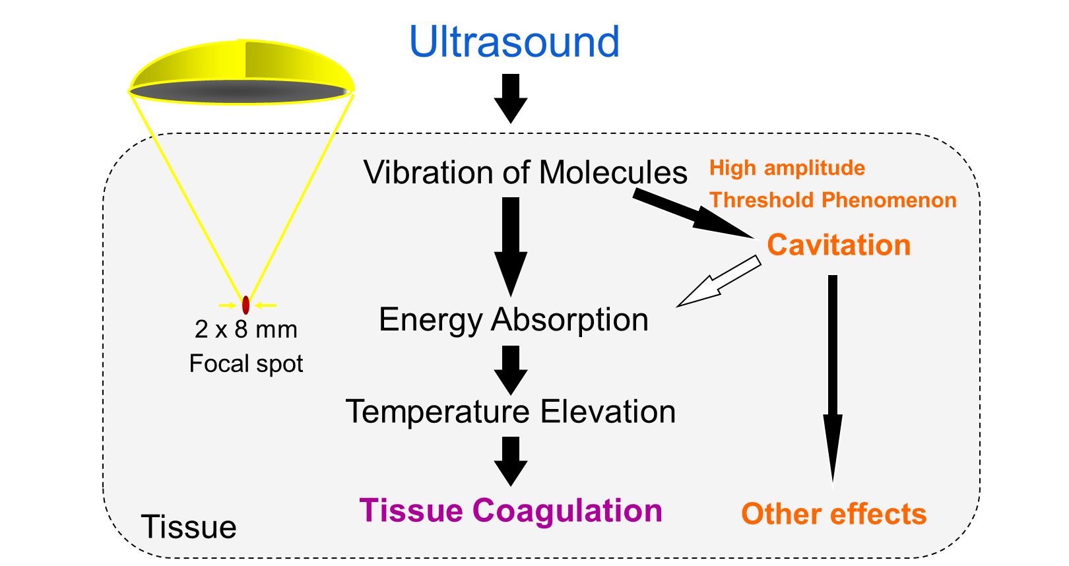
What is Focused Ultrasound?
HIFU is a process which can be used for destroying cancerous tissue using hyperthermia
Transducer produces 40W Ultrasound signal at 1.2 MHz. Ultrasound signal is focused into a region 8mm x 2mm x 2mm.
Pressure variations due to the ultrasound lead to a temperature source Q(x; t).
Temperature T(x; t) changes due to the action of the source diffusion and perfusion due to blood flow.
High temperatures over a sustained time lead to tissue damage.

Slide 5
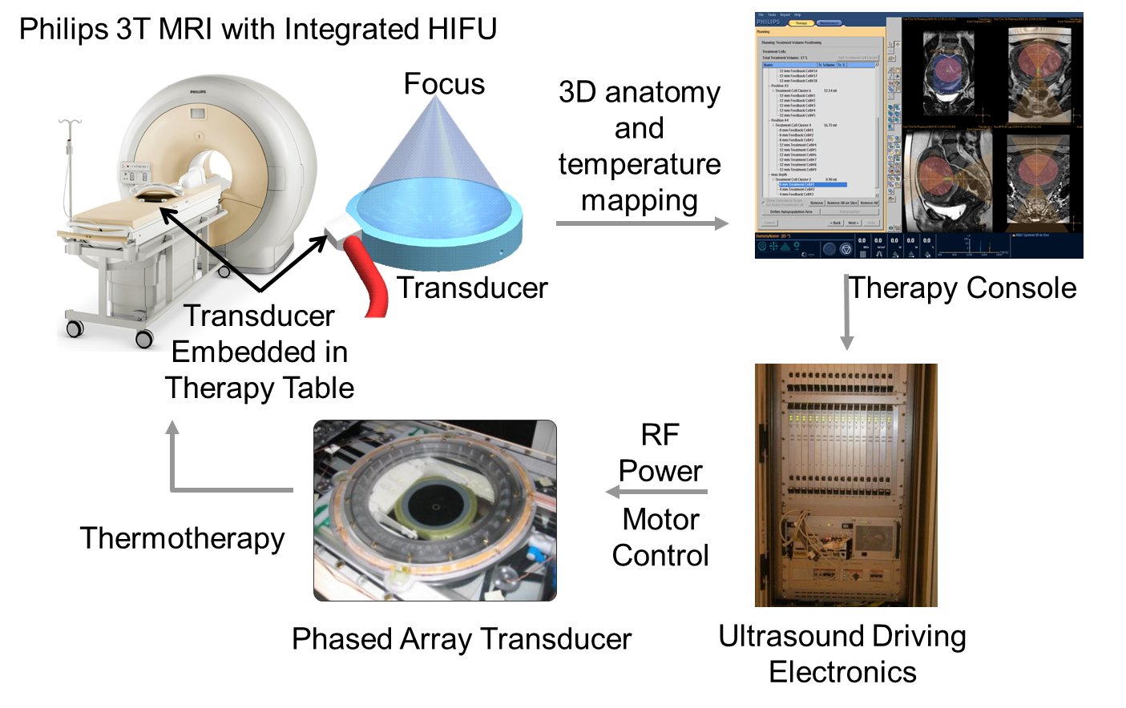
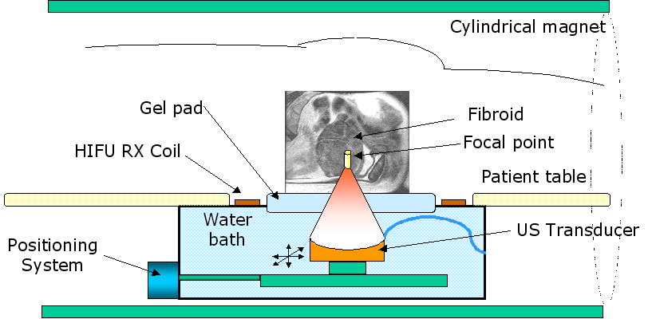
System Set Up

Slide 6
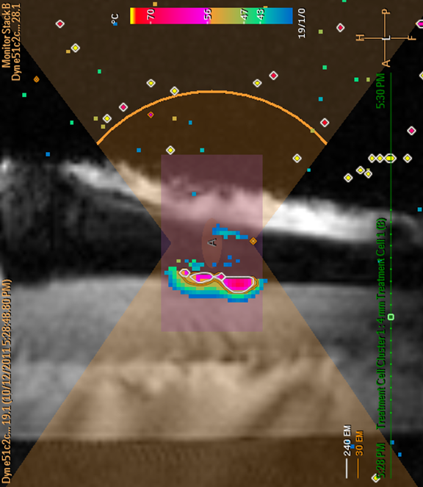
Imaging
MR Thermometry
Temperature measurement is based on the water proton resonance frequency (PRF) shift induced phase differences between dynamic frames of MR image
Temperature in bone and fat tissue can not be measured with the PRF method
The phase of a MR image is sensitive to disturbances such as transducer movement and magnetic field drift and to patient movement
MR thermometry “closes the loop” to monitor and control treatment temperatures in real time

Slide 7
Pennes Bioheat Transfer Model
Proposed in 1940s for modeling heat transfer in the body due to an externally applied heating/cooling sources
Harry Pennes (a Neurologist at Columbia University ) experimented on patients by inserting thermocouples into patients’ forearms
Model accounts the thermal conductivity, specific heat capacity, and blood perfusion of specific tissue types (muscle, organs, skin, etc)

Slide 8
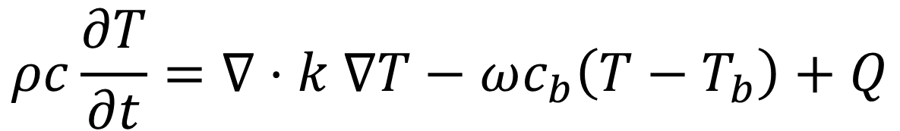
Pennes Bioheat Transfer Equation
$$ρc\frac{∂T}{∂t}=∇⋅k ∇T−ωc_{b}\left(T−T_{b}\right)+Q$$
Simple intuitive model that has stood the test of time
Do the constants remain constant?
The perfusion term is normally a few orders of magnitude smaller than the other terms. Are there circumstances where it becomes significant?
How to we model Q?
Point source/ Gaussian source/…
Is Q affected by the attenuation constants of different tissues? Yes – How?

Slide 9
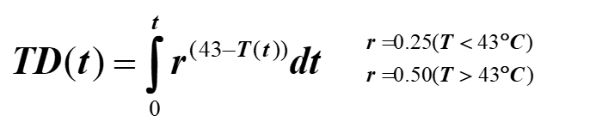
Thermal Dose Model
Thermal dose is calculated on a voxel by voxel basis as a time integral as temperature is measured throughout treatment
240 EM (equivalent minutes) at 43°C is sufficient to cause thermal necrosis in “soft tissue”
1 second exposure at 57°C can produce thermal necrosis (273 EM)

Slide 10
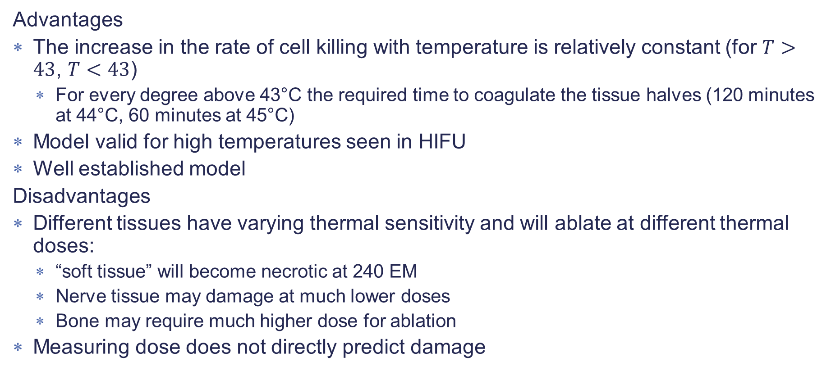
Thermal Dose Model
Advantages
The increase in the rate of cell killing with temperature is relatively constant (for $T>43$, $T<43$)
For every degree above 43°C the required time to coagulate the tissue halves (120 minutes at 44°C, 60 minutes at 45°C)
Model valid for high temperatures seen in HIFU
Well established model
Disadvantages
Different tissues have varying thermal sensitivity and will ablate at different thermal doses:
“soft tissue” will become necrotic at 240 EM
Nerve tissue may damage at much lower doses
Bone may require much higher dose for ablation
Measuring dose does not directly predict damage

Slide 11



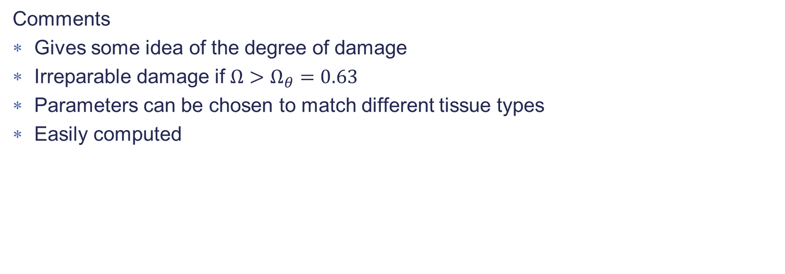
Another idea – Zhou, Chen and Zhang 2007
Model thermal damage as a result of irreversible protein denaturisation
$$P→D$$
P=folded protein, D= denatured protein
Reaction rate
Where $ΔG$= activation energy and R= universal gas constant
Damage Fraction
Comments
Gives some idea of the degree of damage
Irreparable damage if $Ω>Ω_{θ}=0.63$
Parameters can be chosen to match different tissue types
Easily computed

Slide 12
Current Work

Slide 13
Aims
Work on modelling of heat transfer which encompasses:
Thermal conductivity
Thermal diffusion
Specific heat capacity
Perfusion
Of the tissue of interest but also including its surrounding structures
Use this to model thermal dose and thermal damage of the tissues and surrounding structures.

Slide 14
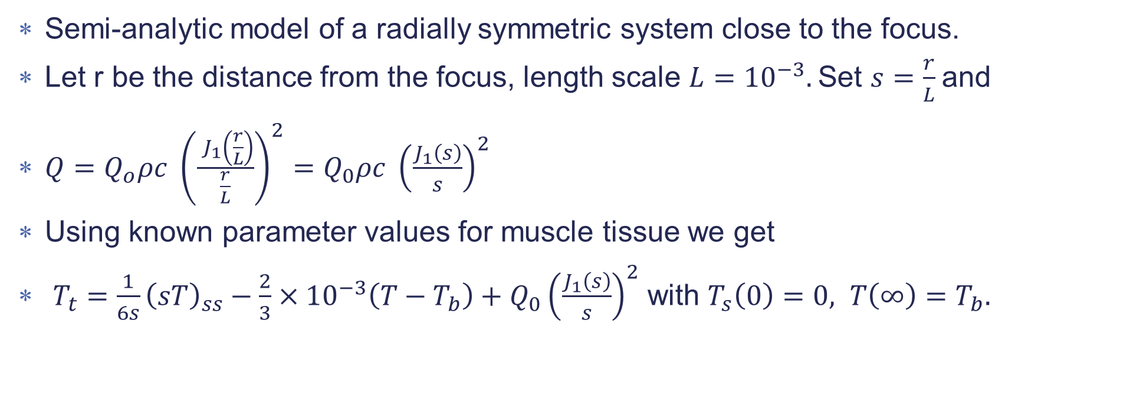
Current Work - 1D Model
Semi-analytic model of a radially symmetric system close to the focus.
Let r be the distance from the focus, length scale $L={10}^{−3}.$Set $s=\frac{r}{L}$and
$Q=Q_{o}ρc {\left(\frac{ J_{1}\left(\frac{r}{L}\right)}{\frac{r}{L}}\right)}^{2}=Q_{0}ρc {\left(\frac{J_{1}\left(s\right)}{s}\right)}^{2}$
Using known parameter values for muscle tissue we get
$T_{t}=\frac{1}{6s}{\left(sT\right)}_{ss}−\frac{2}{3}×{10}^{−3}\left(T−T_{b}\right)+Q_{0}{\left(\frac{J_{1}\left(s\right)}{s}\right)}^{2}$ with $T_{s}\left(0\right)=0, T\left(∞\right)=T_{b}.$

Slide 15
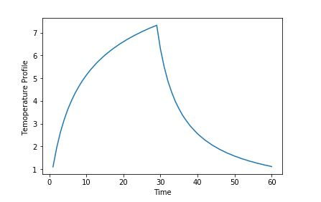
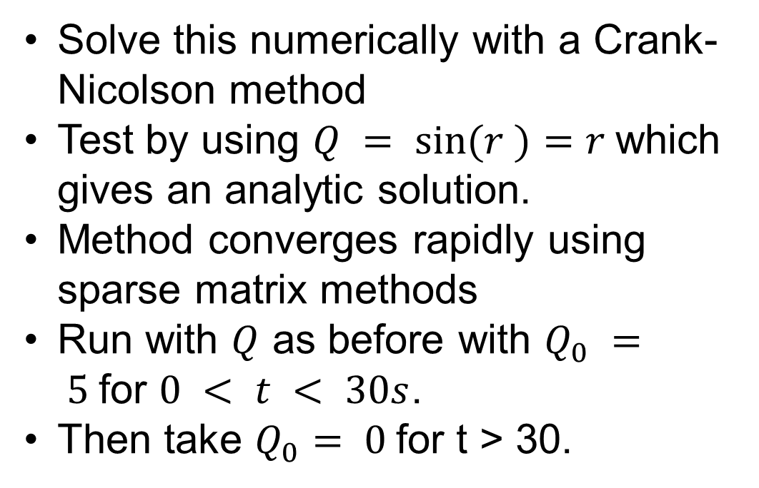
1D Model
Solve this numerically with a Crank-Nicolson method
Test by using $Q = sin⁡(r )=r$which gives an analytic solution.
Method converges rapidly using sparse matrix methods
Run with $Q$ as before with $Q_{0} = 5$for $0 < t < 30s$.
Then take $Q_{0}= 0$for t > 30.

Slide 16
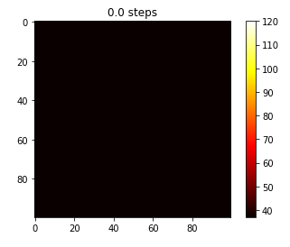
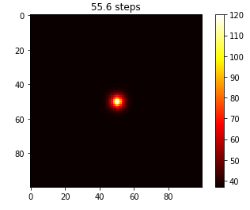
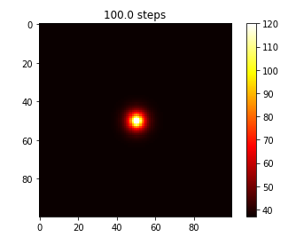
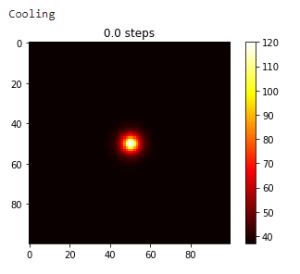
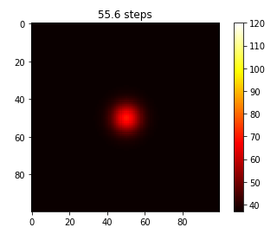
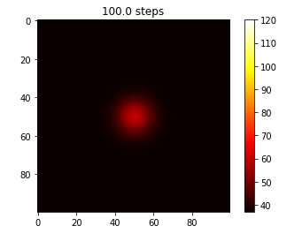
2D Model - muscle tissue
Thermal conductivity, thermal diffusion, specific heat capacity, perfusion constants taken for muscle
Q modelled as a Gaussian at the centre of the area of interest
37 degrees Dirichlet boundary conditions
Central difference in space forward difference in time

Slide 17
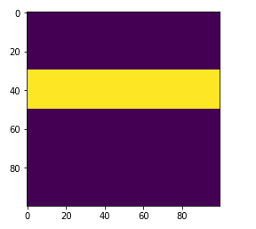
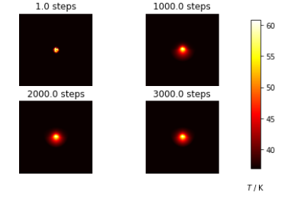
2D model with bone
As before but thermal conductivity, thermal diffusion, specific heat capacity, perfusion constants vary over the region

Slide 18
Next Steps
Add in thermal dose/ thermal damage modelling
Look into the physics of how the attenuation constant will affect the heating source, Q
Improve efficiency and stability of code
Crank-Nicholson method for time
Semi-discretised method using an inbuilt ODE solver, e.g. odeint in python
Look at other tissue types, including where the perfusion term is more significant

Slide 19
Questions

Slide 20
Python Demonstration

